Slide 1
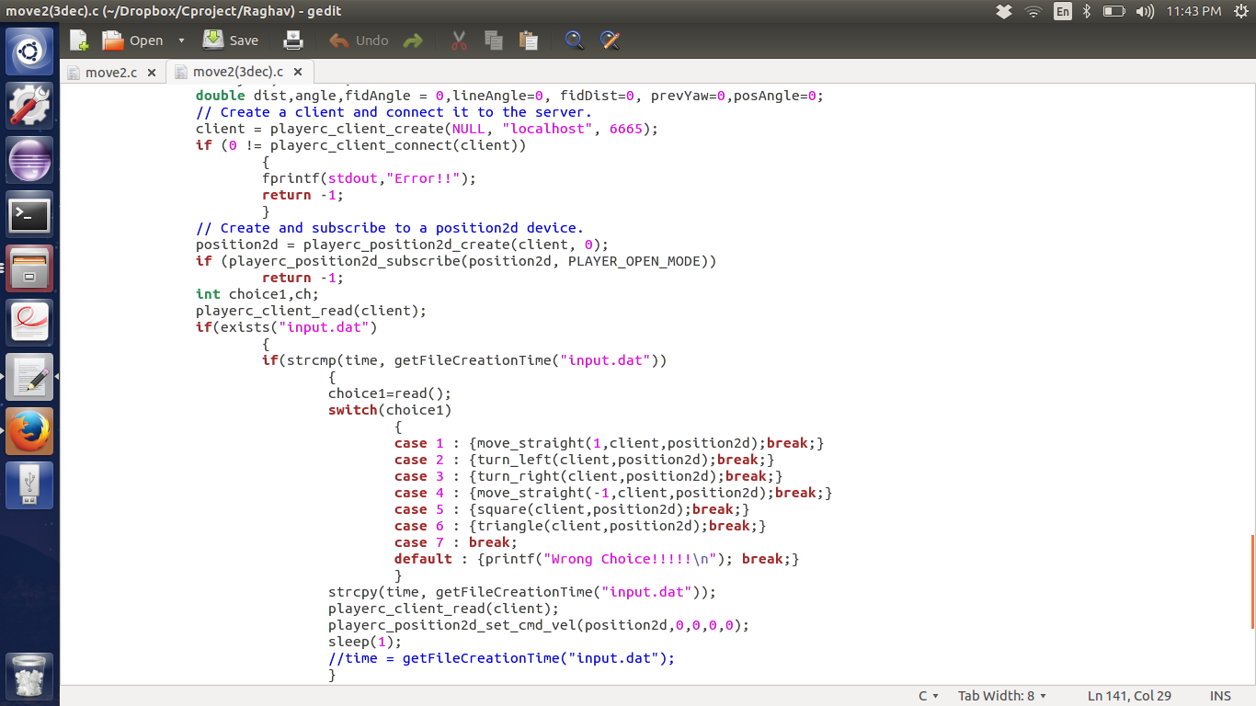
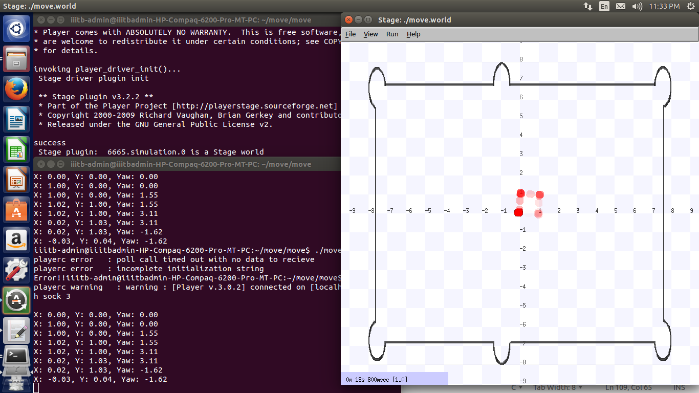
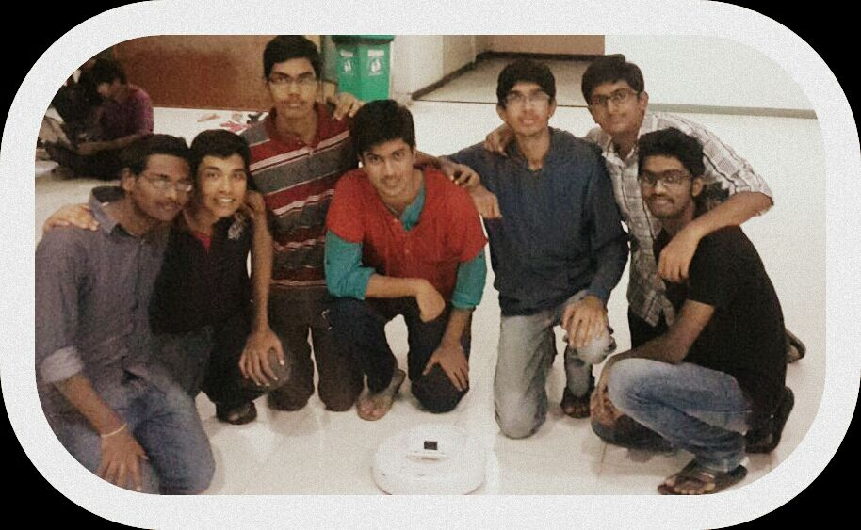
V-REC ROBOT
Conclusions and future work:
.
->This project gave us an exposure to the “Robot” world.
->It also encouraged us to test new technoogy such as player stage,other voice-recognisation softwares.
->Our future work is to add more features to the robot.
Suprgya,Raghav,Ramaraju,Dharma,Shravan,Rahul,Karthik
International Institute of Information Technology,Bangalore
Introduction:
->Our project is a voice recognisation robot.
->It works on the following aspects:
*Voice-Recognisation
*Robot-Movement
Results:
Commands:
Dial one->moving straight Dial two->turning left
Dial three->turning right Dial four->moving reverse
Dial seven->moving in a square path Dial eight->moving in a triangular path
Materials and methods:
Materials:
*Irobot Create
*BAM(Bluetooth Access Module)
*Julius Software
*Laptop
*PlayerStage Software
Methods:
1.First, conversion of speech to a text file through the Julius Software.
2.Then,we read the text file and implement the six commands according to the code
3.This is all happening live.
Acknowledgments:
->We would like to thank Prof.Madhav Rao and Vivek Sir.
->We would also like to thank our seniors Arun Prasad, and Ved Vyas.
->Finally ,we would like to thank the institute for provinding us with the robot .
Source Code Stimulator
Group Photo :
References:
1. Madhav Rao Sir 4.SourceForge
2. Julius Book
3. Player Stage (playerstage.sourceforge.net)
Notes:
Copyright Colin Purrington (http://colinpurrington.com/tips/academic/posterdesign).

